Slide 1
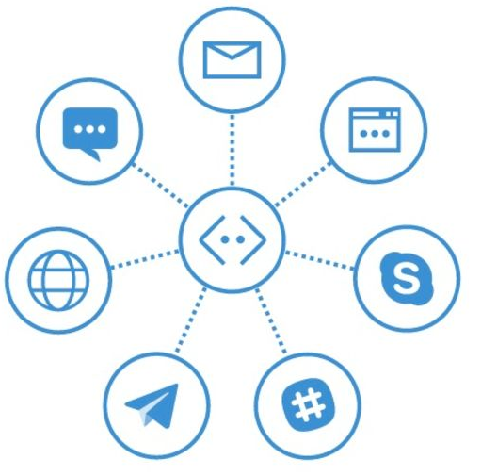

Building Intelligent Applications Using Bot Framework
Mithun Prasad, PhD miprasad@Microsoft.com

Slide 2


What is a Bot?

Slide 3
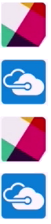
What a Bot is Not
Artificial Intelligence only
Text interfaces only
Natural Language Processing only
ryanv 8:26 AM
Cancel
Azure Bot Bot 8:26 AM
You have canceled the operation. What would you like to do next?
ryanv 8:26 AM
login
Azure Bot Bot 8:26 AM
Please select the subscription you want to work with:
Event Bots
QA Environment 1

Slide 4
What is a Bot?
Simply put, a bot is an application that performs an automated task. That’s it

Slide 5

Principles of Bot Design

Slide 6
Bot Design
Assumptions
- Expect users to use the bot
- Users prefer the bot experience over alternative experiences (apps, websites, phone calls, etc)
Prioritize the right factors when designing your bot

Slide 7
Factors that do not guarantee a Bot's success
How “smart” the bot is
- Smarter bots may not guarantee happy users and adoption of your platform
- Many bots have little NLP capabilities
How much natural language the bot supports
- Bots can be great at conversations
- Bots can have a vocabulary and can even make great jokes
- Unless it addresses core problems, these capabilities may contribute very little to making your bot successful
- Some bots have no conversational capability. And in many cases, that's perfectly fine

Slide 8
Factors that do not guarantee a Bot's success
Voice
- Enabling bots for speech may not always lead to great user experiences
- Forcing users to use voice can result in a frustrating user experience
- Key considerations
- Is voice the appropriate channel for the given problem?
- Is the environment noisy?
- Will voice convey the information that needs to be shared with the user?

Slide 9
Factors that do influence a Bot's success
A great user experience
Key considerations:
- Does the bot easily solve the user’s problem with the minimal steps?
- Does the bot solve the user’s problem better/easier/faster than any of the alternative experiences?
- Does the bot run on the devices and platforms the user cares about?
- Is the bot discoverable? Do the users naturally know what to do when using it?

Slide 10
Types of Bots

Slide 11
How Should We Categorize Bots?
Bot classification is arbitrary.
- Generalist bots vs Specialist bots
- Good bots vs Bad bots
- State related bots

Slide 12
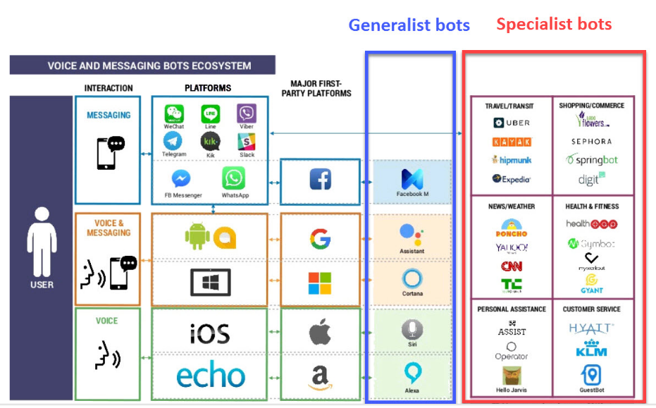
Generalist Bots vs Specialist Bots
Recognize a primary market dynamic

Slide 13
Generalist Bots vs Specialist Bots
Generalist bots
- Can understand what you’re asking
- No specific domain expertise to follow through with action
- In the enterprises, it is common where solutions are hard to generalize
Specialist bots
- Provides domain-specific knowledge necessary to accomplish tasks

Slide 14
Good Bots vs Bad Bots
Chatbots
Crawlers
Transactional bots
Informational bots
Entertainment bots: Art bots, Game bots
Good Bots
Bad Bots
Hackers
Spammers
Scrapers
Impersonators

Slide 15
Good Bots
Chatbots | Designed to carry forward conversations with humans and help in automation.
Informational bots | Obtain helpful information (for example, push notifications) and include things like breaking news stories.
Crawlers | These bots run in the background, primarily fetch data from other APIs or websites, and are “well-behaved” Example: Pricing Assistant is bot that monitors ecommerce websites for price changes
Transactional bots | Act as agents on behalf of humans, and interact with external systems Example: A scheduler that finds meeting times for distributed teams

Slide 16
Bad Bots
Hackers | Designed to distribute malware, deceive individual people, attack websites, and sometimes entire networks
Scrapers | Scraper bots steal content from other websites
Spammers | Post promotional content around the web, and eventually drive traffic to the spammer’s website
Impersonators | Mimic natural user characteristics, making them hard to identify.

Slide 17
State related Bots
Bots can also be split into the following categories:
- Stateless bots
- Semi-sateful bots
- Stateful bots

Slide 18
Stateless Bots
Example: Cleverbot (https://cleverbot.io/)
The services they offer are quite frivolous. Their main purpose is to bring entertainment value
- We can send some text to this bot and it will process and reply
- The conversation works but without reaching any definitive end goal
- The bot does not keep any memory of messages (i.e. it does not maintain the state of the conversation)
- Not capable of any learning

Slide 19
Semi-stateful Bots
Example: Automated Phone Menu System
- Limited ability to keep track of the conversation
- Unlike stateless bots, semi-stateful bots do not process each message as if it is coming from a brand new user
- Persist the basic details about the user (i.e. user ID, or phone number, etc.)
- The state they maintain is quite shallow
- Limit their state to a single conversation session with the user. If the user reaches their goal, the conversation ends

Slide 20
Stateful Bots
- Stateful bots keep the entire history of each conversation they had with the user
- The history of conversations can be used to adjust responses
- Query user for preferences
- Question and Answer

Slide 21
Microsoft Bot Framework

Slide 22



Bot Builder SDK
Bot Framework Developer Portal
Bot Directory
Dev
Connect
Publish

Slide 23
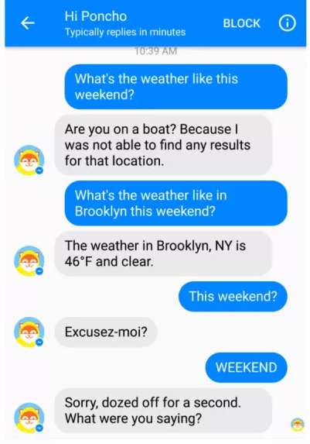
Bot Framework
Bot Framework
Bot Framework is a Microsoft – operated service and SDK
Bot Framework is one of many tools Microsoft offers for building a complete bot
Others include: LUIS, Speech APIs, Azure, more

Slide 24
Bot Framework – Part 1
Your bot
Logic
Bot Builder SDK
(Node.js + c#)
Web
service
LUIS

Slide 25
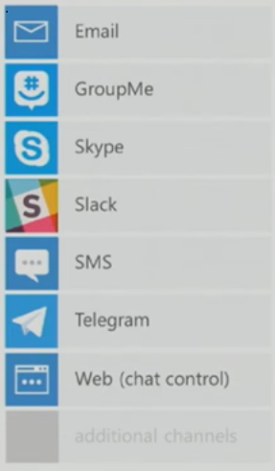
Bot Framework – Part 2
Bot Connector
Channels
Portal
Bot Connector
Send/receive messages
Store state
Translation
Telemetry
…
Your bot

Slide 26
Bot Connector Message
Your bot
Bot
Connector
{
“type” : “message” ,
“id” : 68YrxgtB53Y” ,
“conversationId” : “DphpaFQrDuZDKyCez4AFGcT4vy5aQDjellLGIjB8v18MFtb”,
“language” : “en” ,
“text” : “You can say \ “/ order\” to order!”,
“attachments” : [ ],
“from” : {
“name” : “+12065551212”,
“channelId” : “sms”,
“address” : “ +12065551212”,
“id” : “Ro52hKN287”,
“isBot” : false
},
“channelData” : { SMS data here },
…
}

Slide 27
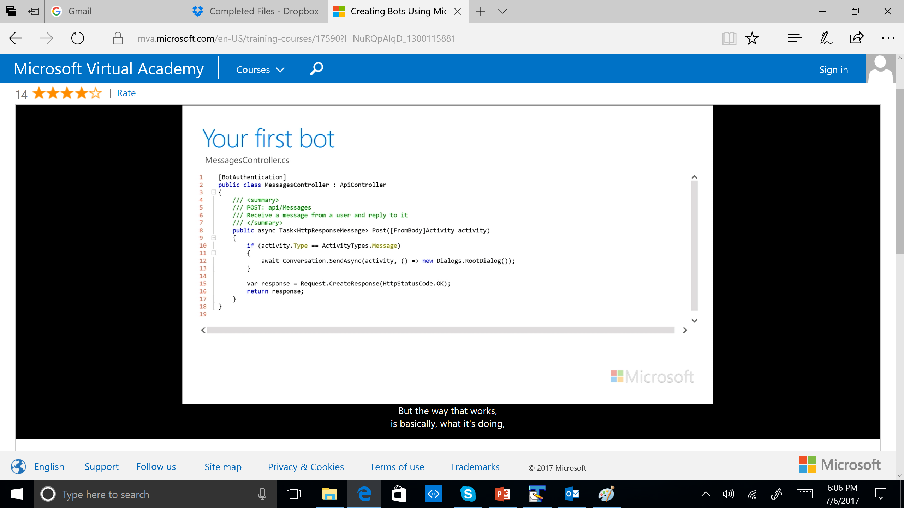
MessagesController

Slide 28
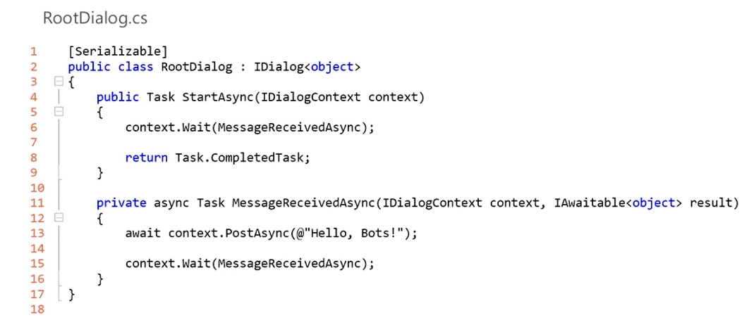
RootDialog

Slide 29
Key Concepts

Slide 30
Key Concepts
Bot Connector service
- The Bot Connector service enables your bot to exchange messages with channels configured in the Bot Framework Portal
- It uses industry-standard REST and JSON over HTTPS
Client libraries
- The Bot Framework provides client libraries ( Bot Builder SDK) that can be used to build bots in either C# or Node.js. The SDK provides support for:
Dialogs that encapsulate conversational logic
Built-in prompts for Yes/No
Powerful AI frameworks such as LUIS, and more

Slide 31
Key Concepts
Channel
- A channel is the connection between the Bot Framework and communication apps such as:
Skype
Slack
Facebook Messenger
Office 365 mail
Others
- The Developer Portal is used to configure the channel
- Skype channel is the default channel

Slide 32
Key Concepts
Activity
Bot Connector service exchanges information between bot and channel (user) by passing an Activity object
Activity type | Description
message | Represents a communication between bot and user.
conversationUpdate | Indicates that the bot was added to a conversation, other members were added to or removed from the conversation, or conversation metadata has changed.
contactRelationUpdate | Indicates that the bot was added or removed from a user's contact list.
typing | Indicates that the user or bot is compiling a response.
ping | Represents an attempt to determine whether a bot's endpoint is accessible.
deleteUserData | Indicates to a bot that a user has requested that the bot delete any user data it may have stored.
endOfConversation | Indicates the end of a conversation.

Slide 33
Key Concepts
State Data
State data can be used for many purposes:
Determine where a prior conversation left off
Greet a returning user by name
With user’s preferences, you can customize the conversation the next time you chat:
Example 1: Alert a user to a news article about a topic that is of interest
Example 2: Alert a user when an appointment becomes available
Bot State Service
Enables your bot to store and retrieve state data that is associated with a user, a conversation, or a specific user within the context of a specific conversation
Uses industry-standard REST and JSON over HTTPS
Enables authentication with JWT Bearer tokens

Slide 34
Key Concepts
Authentication
Both the Bot Connector service and the Bot State service enable authentication with JWT Bearer tokens
JWT Bearer tokens
JSON Web Token (JWT) is an open standard that defines a compact and self-contained way for securely transmitting information between parties as a JSON object
This information can be verified and trusted because it is digitally signed

Slide 35
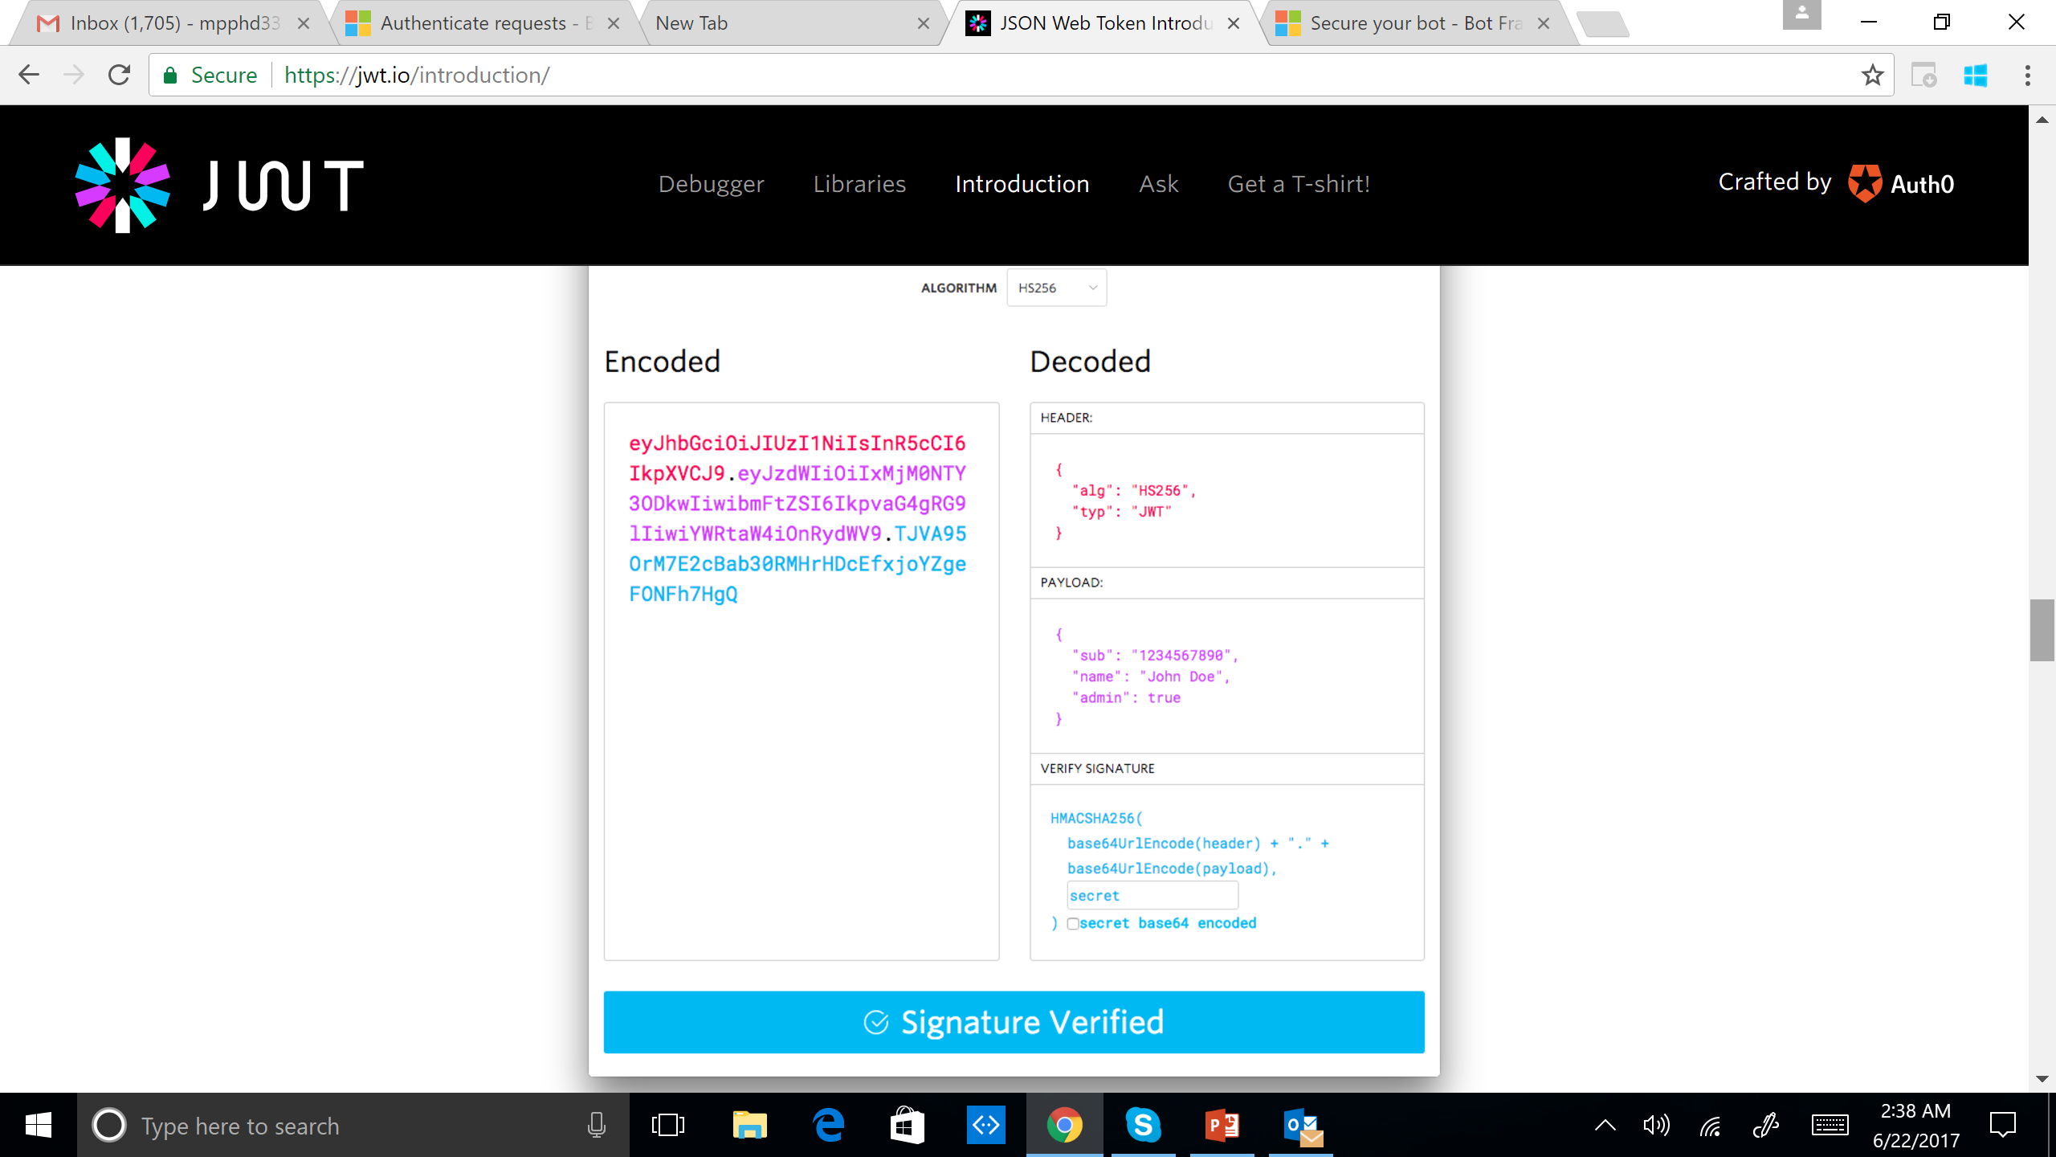
JWT Bearer Tokens
https://jwt.io/

Slide 36
Secure your Bot
Use HTTPS and Bot Framework Authentication
To ensure that the bot's endpoint can only be accessed by the Bot Framework Connector, configure the bot's endpoint to use only HTTPS and enable Bot Framework authentication by registering your bot to acquire its app Id and password
Configure authentication
After the bot is registered, specify its app Id and password in your bot's web.config file.
<appSettings>
<add key="MicrosoftAppId" value="_appIdValue_" />
<add key="MicrosoftAppPassword" value="_passwordValue_" />
</appSettings>

Slide 37
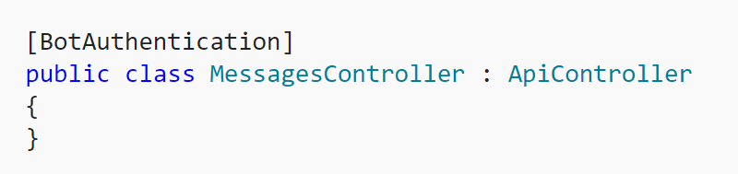
Secure your Bot
Authentication Credentials using Bot Builder SDK for .NET
To use the authentication credentials that are stored in the web.config file, specify the [BotAuthentication] attribute with no parameters

Slide 38
Channel-specific Functionality

Slide 39
Channel-specific Functionality
Some channels provide features that cannot be implemented using only message text and attachments
To implement channel-specific functionality, you can pass native metadata to a channel in the Activity object's ChannelData property
For example, you can instruct Office365 to send an email

Slide 40
Channel-specific Functionality
Email | Send and receive an email that contains body, subject, and importance metadata
Facebook | Send Facebook notifications natively
Telegram | Perform Telegram-specific actions, such as sharing a voice memo or a sticker
Kik | Send and receive native Kik messages

Slide 41
Custom Email Message
Property | Description
htmlBody | An HTML document that specifies the body of the email message. See the channel's documentation for information about supported HTML elements and attributes.
importance | The email's importance level. Valid values are high, normal, and low. The default value is normal.
subject | The email's subject. See the channel's documentation for information about field requirements.
"channelData": {
"htmlBody" : "<html><body>This is the email body!</body></html>",
"subject":"This is the email subject",
"importance":"high"
}

Slide 42
Custom Telegram Message
Property | Description
method | The Telegram Bot API method to call.
parameters | The parameters of the specified method.
"channelData": {
"method": "sendSticker",
"parameters": {
"sticker": {
"url": "https://domain.com/path/gif",
"mediaType": "image/gif",
}
}
}

Slide 43
Facebook Notification
Property | Description
notification_type | The type of notification (e.g., REGULAR, SILENT_PUSH, NO_PUSH).
attachment | An attachment that specifies an image, video, or other multimedia type, or a templated attachment such as a receipt.
"channelData": {
"notification_type": "NO_PUSH",
"attachment": {
"type": "template"
"payload": {
"template_type": "receipt",
. . .
}
}
}

Slide 44
Registration and making your bots available

Slide 45

Developer Portal: What Registration Does for You
Your bot’s web service in the cloud
MS Bot Framework Connector

Slide 46
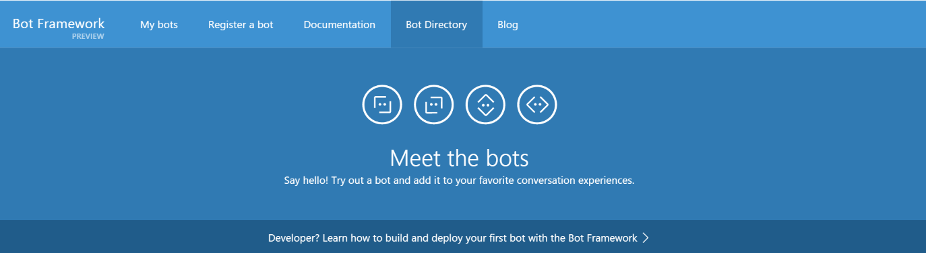
Bot Directory
Public Directory of Bot Framework Bots
Discover, try, and add bots from here with no added configuration
Bots are public at developer discretion; must be reviewed
Searchable here
https://bots.botframework.com/

Slide 47
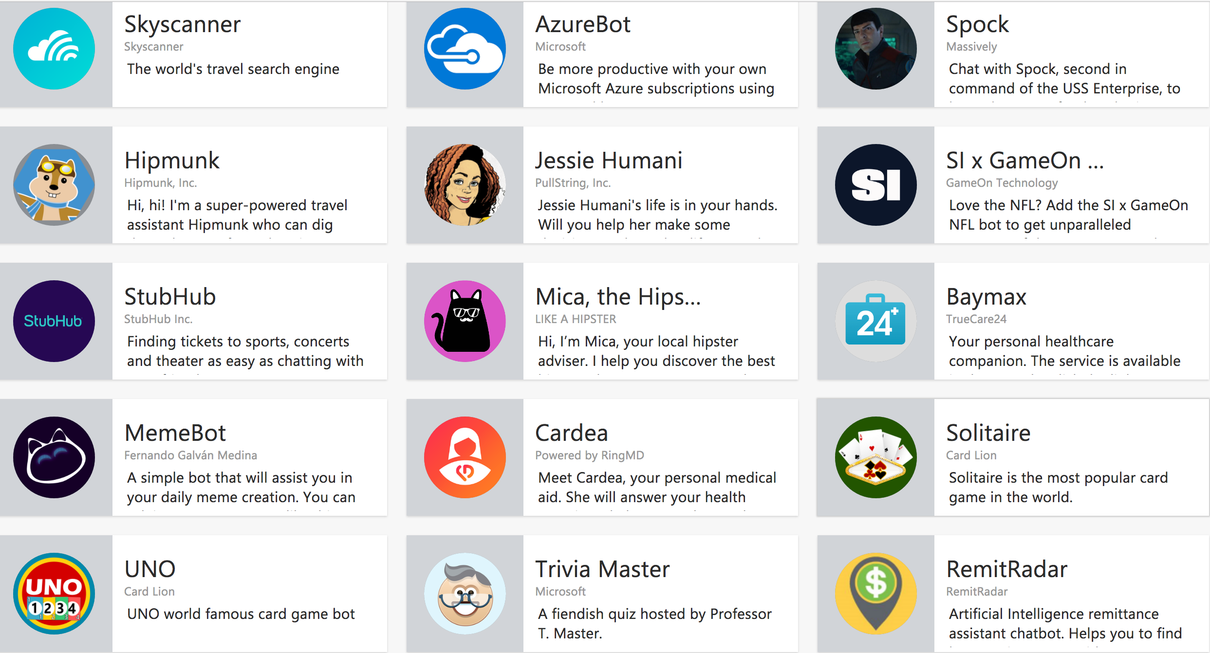
Featured Bots

Slide 48
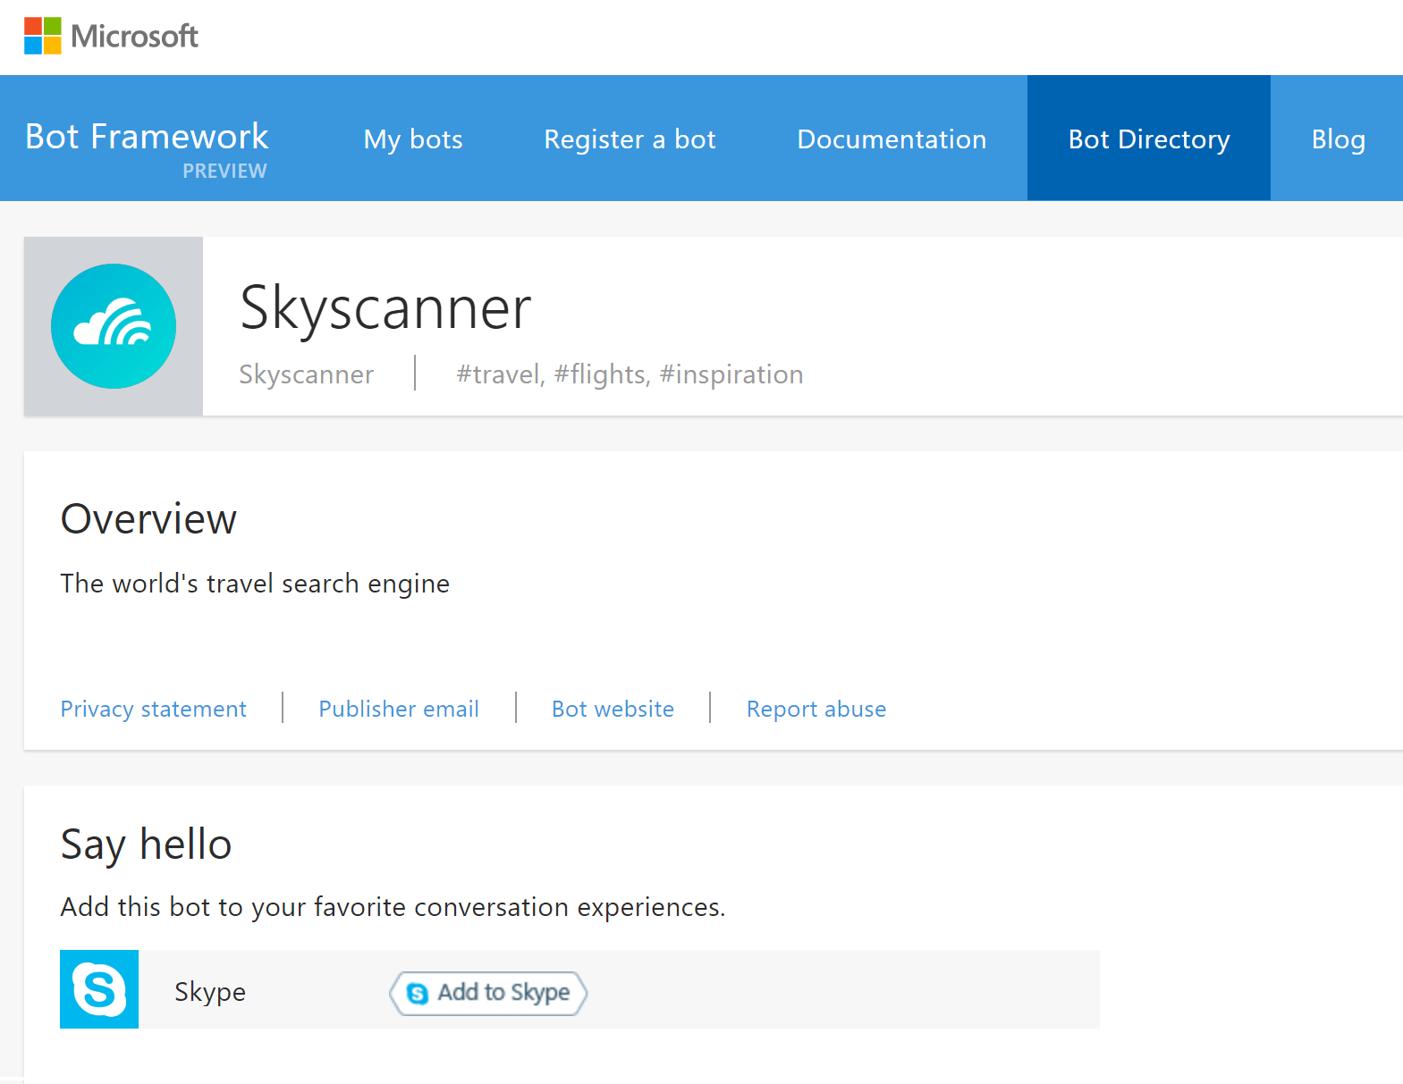
Skyscanner

Slide 49
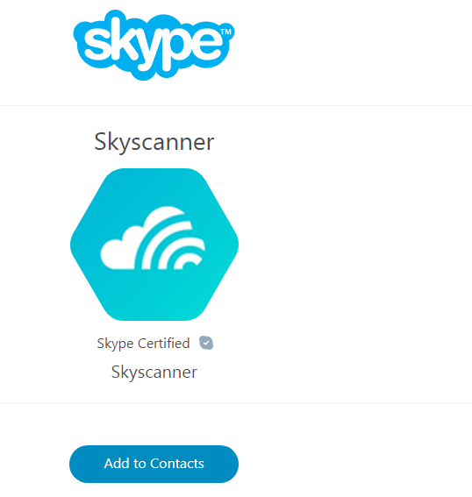
Skyscanner

Slide 50
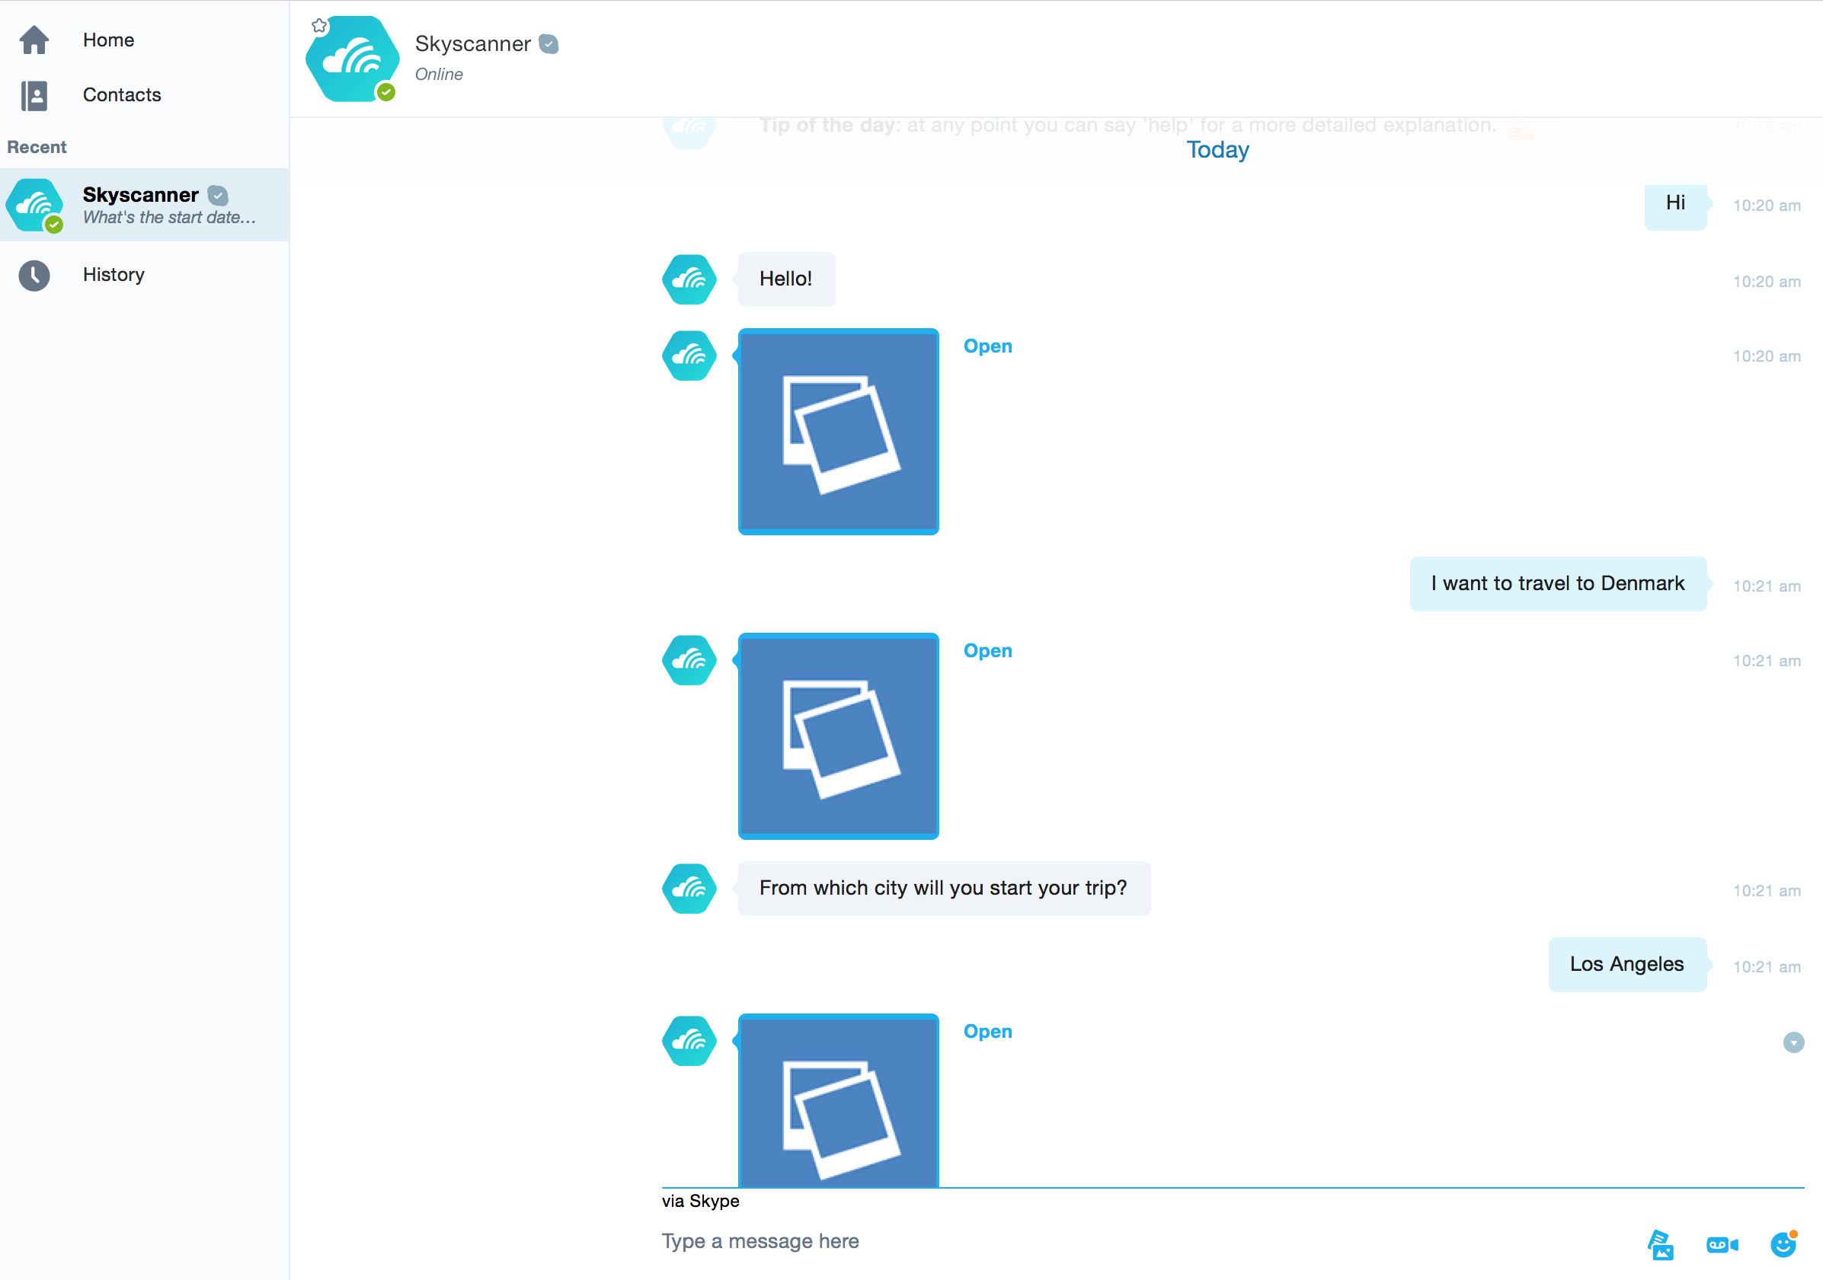

Slide 51
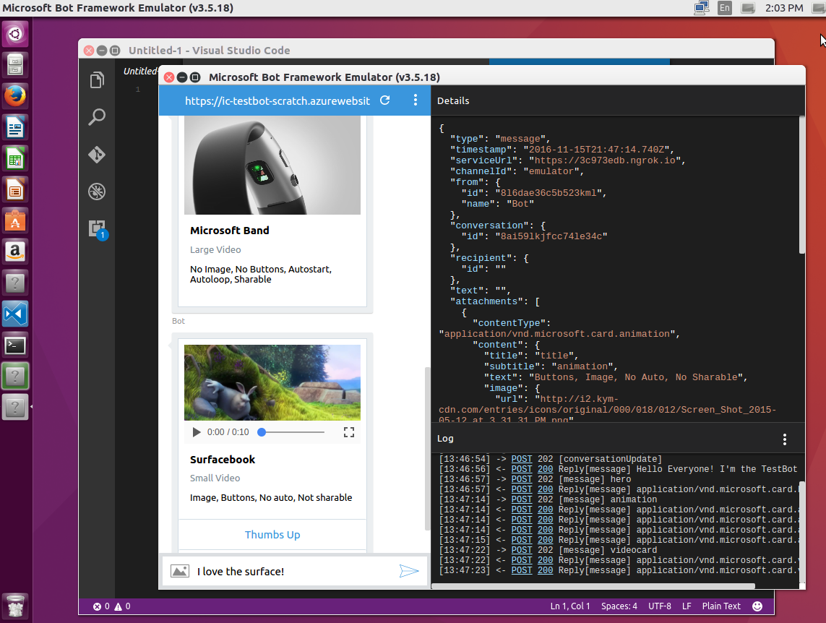
The BF Emulator to Test a Bot
Support for Mac, Linux and Windows
Send requests and receive responses to/from your bot endpoint on localhost
Inspect the Json response Emulate a specific user and/or conversation

Slide 52
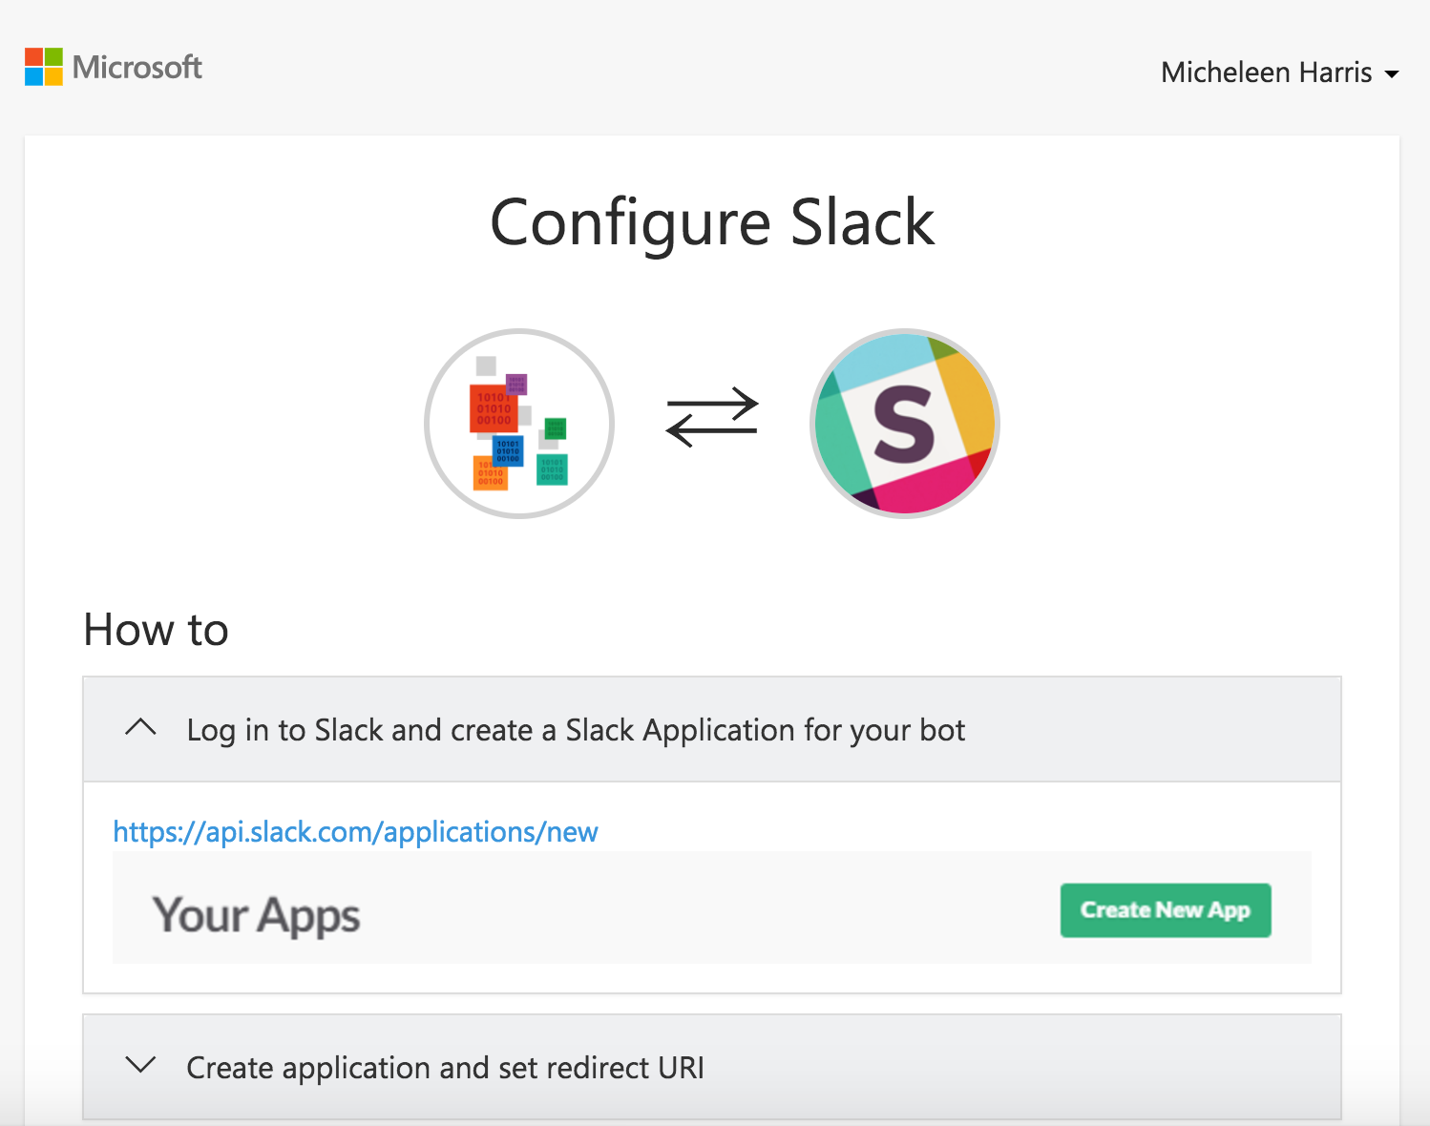
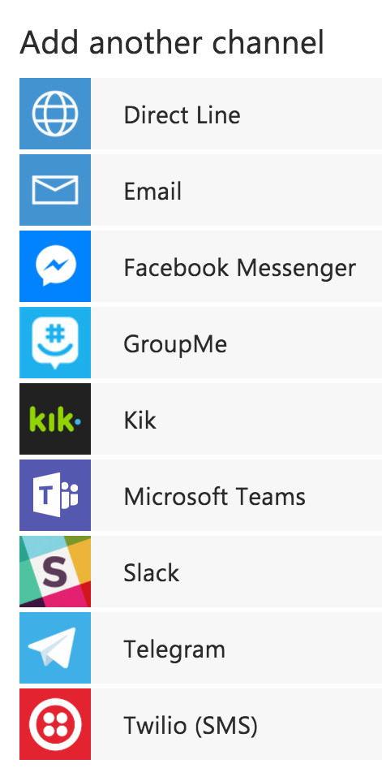
Adding a Channel
Skype is added by default
Instructions are laid out

Slide 53
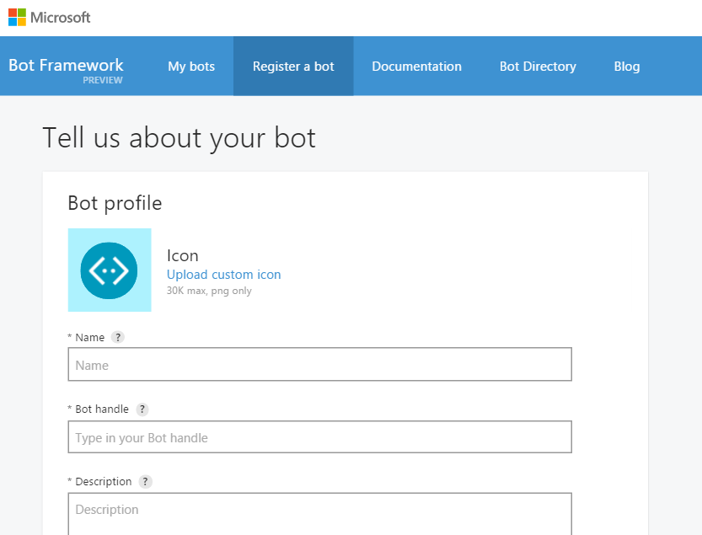
Register a Bot in The Developer’s Portal

Slide 54
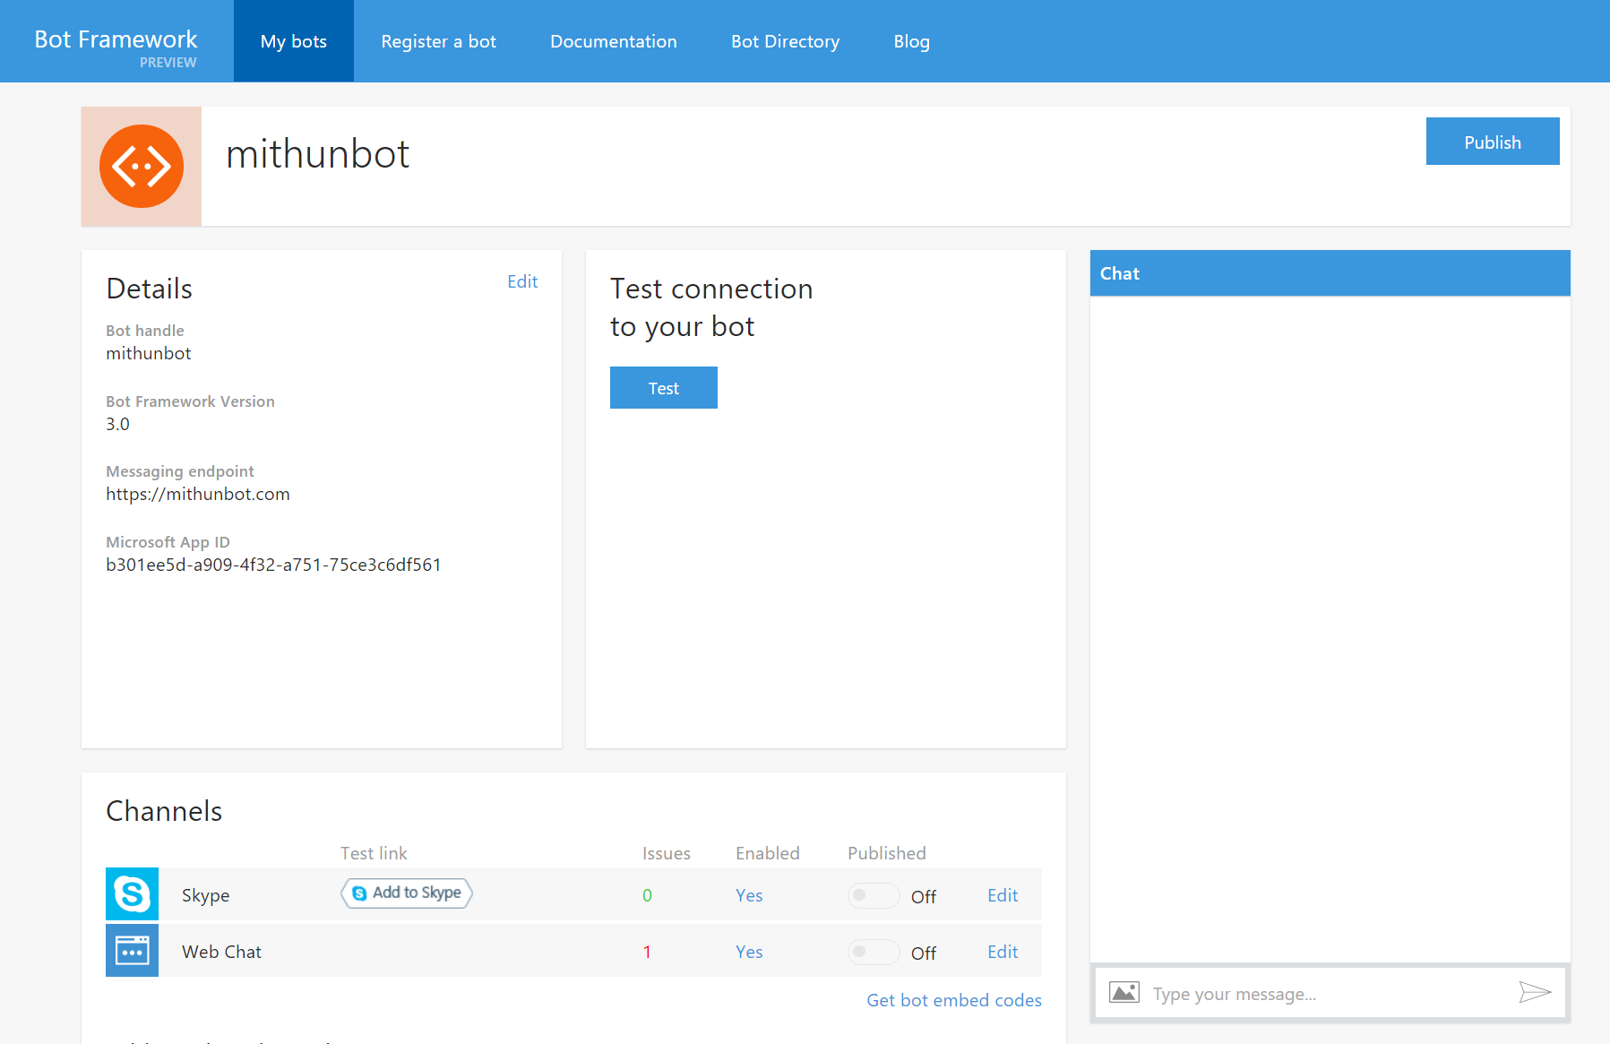
Register a Bot in The Developer’s Portal

Slide 55
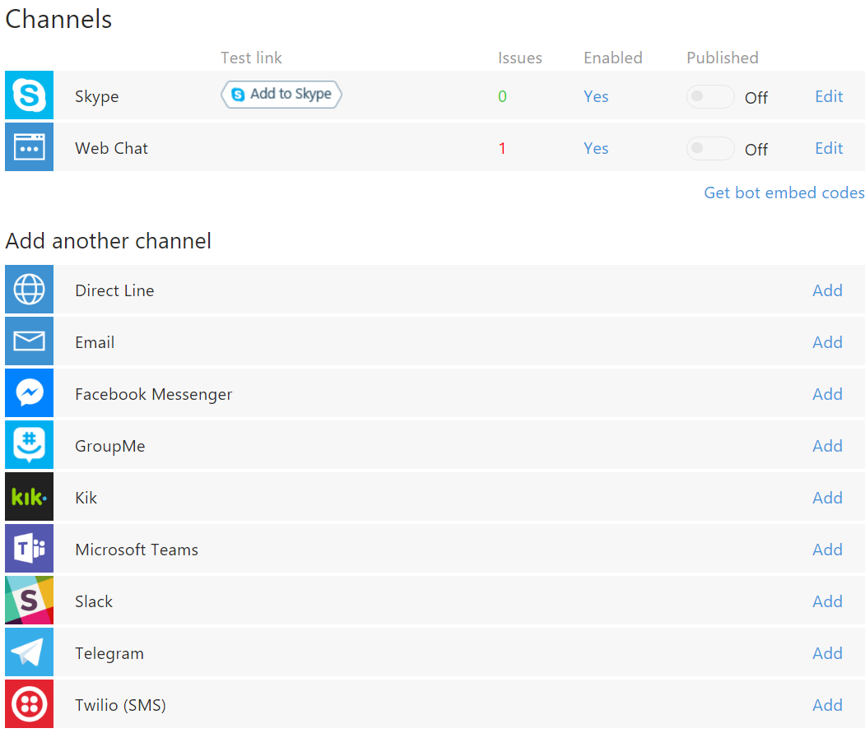
Register a Bot in The Developer’s Portal

Slide 56
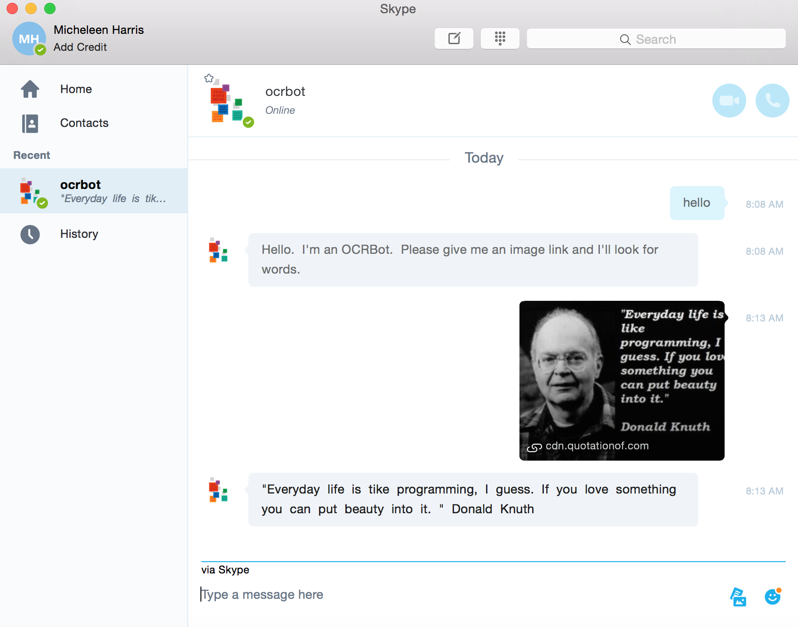
Skype Channel Example

Slide 57
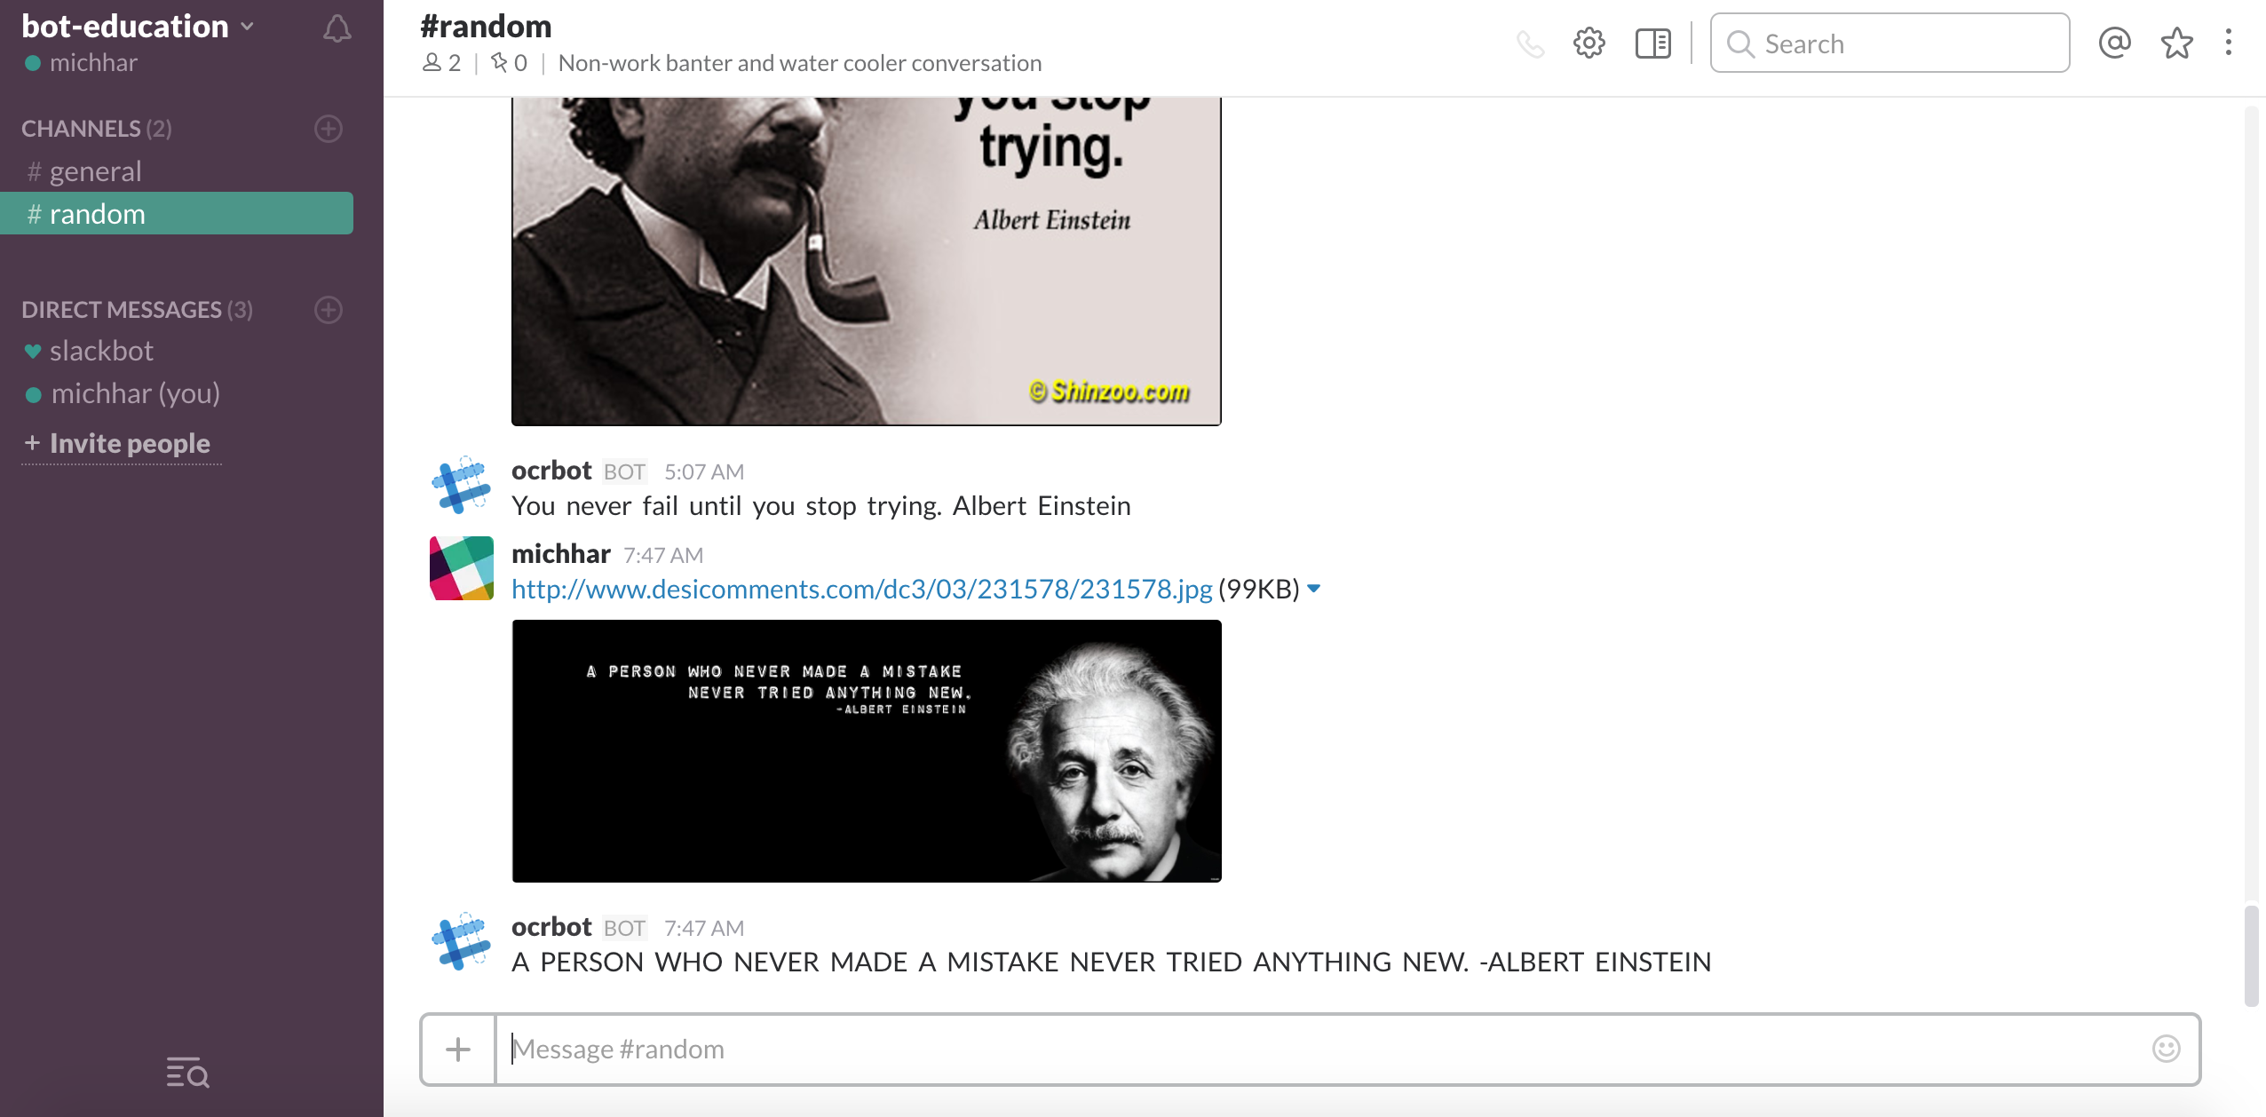
Slack Channel Example

Slide 58
LAB: BotsTennisLab

Slide 59
LAB: BotsPublishingAndRegisteringLab

Slide 60
Messages and Activities

Slide 61
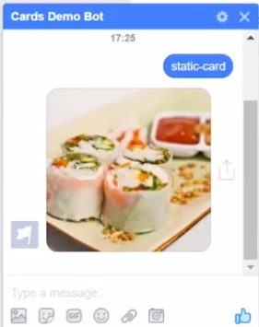
Rich Cards
Provide a title
A subtitle
Some additional text
A button to take some action
And a picture

Slide 62
Rich Cards:
Types of Rich Cards
Card type | Description
AdaptiveCard | Contains any combination of text, speech, images, buttons, and input fields
AnimationCard | Can play animated GIFs or short videos
AudioCard | Can play an audio file
HeroCard | Typically contains a single large image, one or more buttons, and text
ThumbnailCard | Typically contains a single thumbnail image, one or more buttons, and text
ReceiptCard | Typically contains the list of items to include on the receipt, tax and total information, and other text
SignInCard | Typically contains text and one or more buttons that the user can click to initiate the sign-in process
VideoCard | A card that can play videos

Slide 63
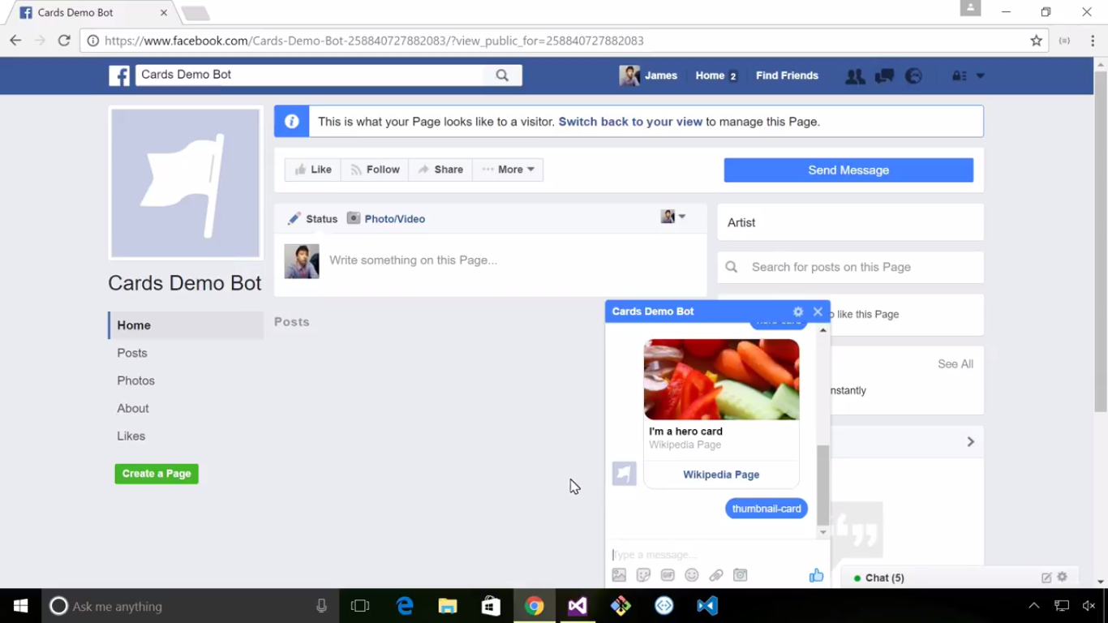
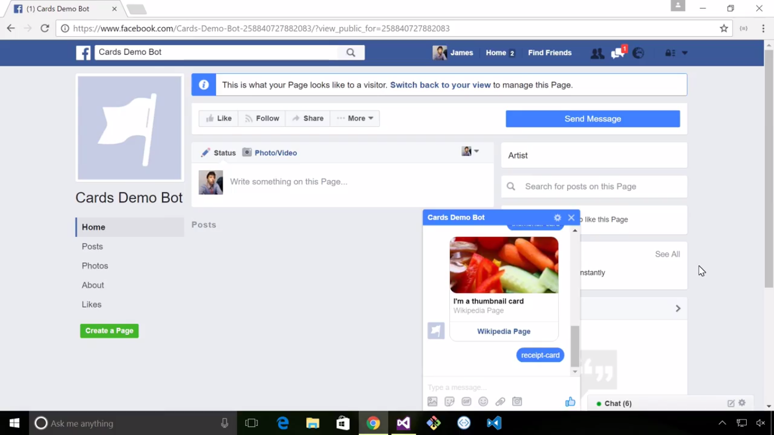
Rich Cards:
Examples

Slide 64
Rich Cards:
Process Events within Rich Cards
Property | Type | Description
Type | string | type of action (one of the values specified in the table below)
Title | string | title of the button
Image | string | image URL for the button
Value | String | value needed to perform the specified type of action

Slide 65
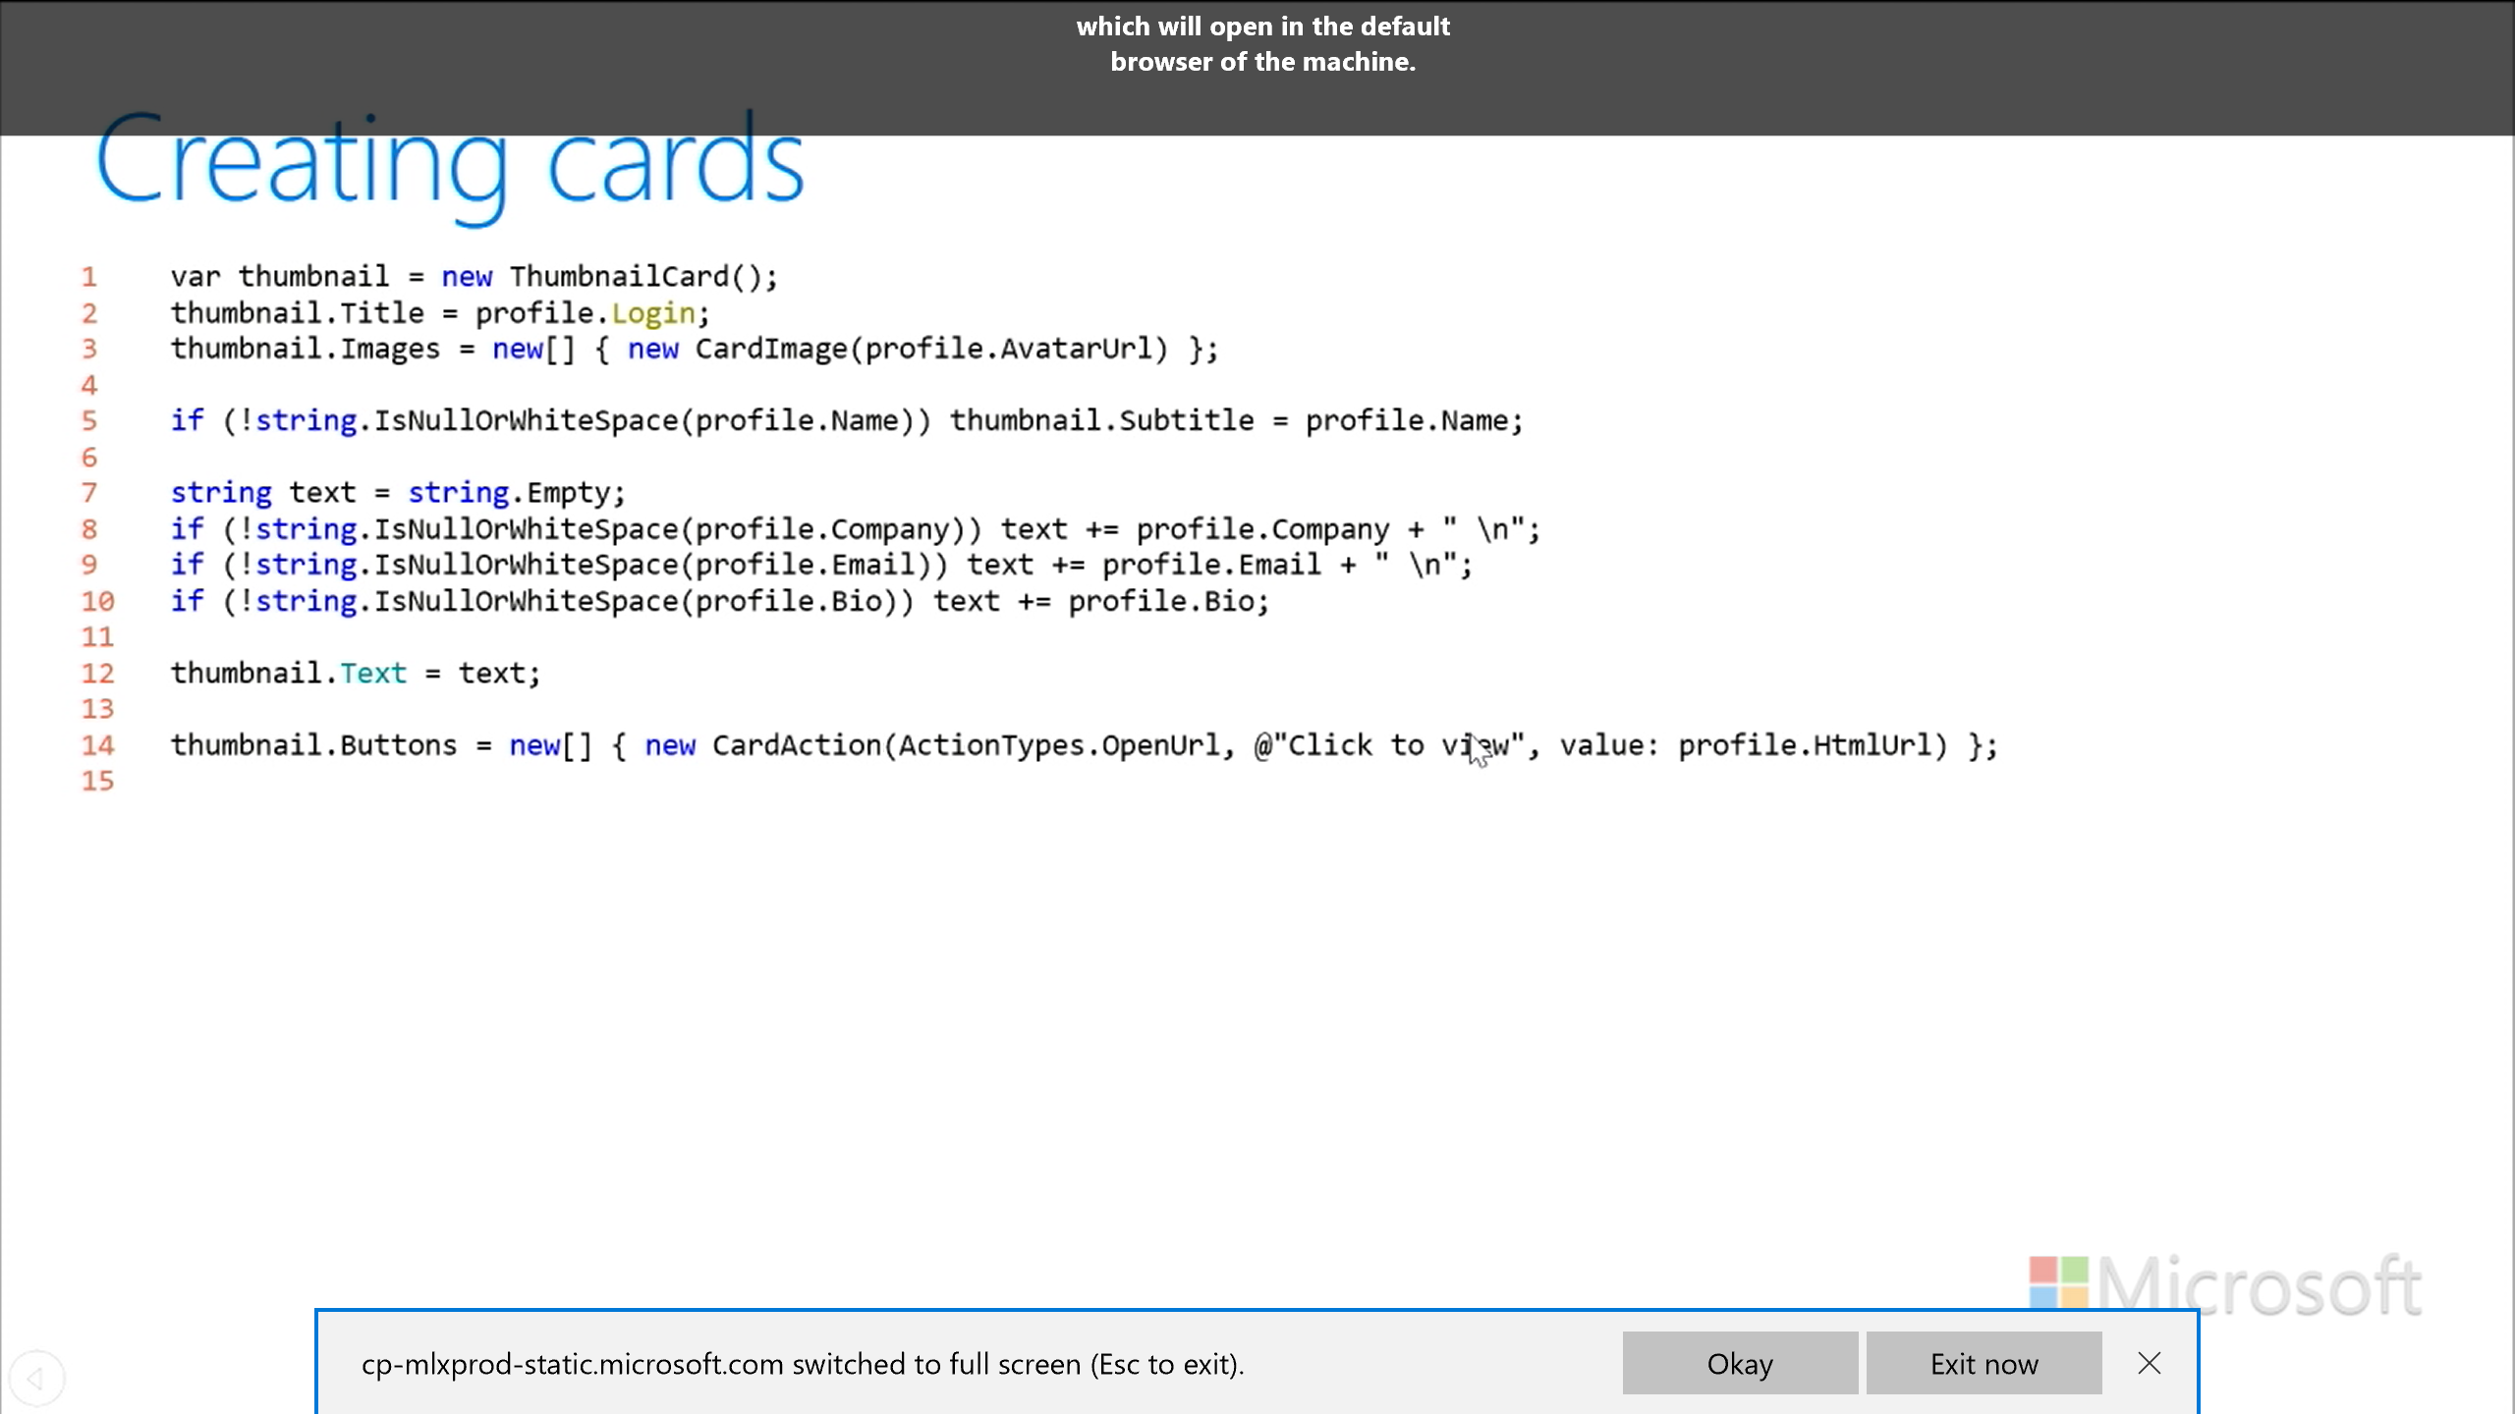
Creating Cards - Thumbnail
The Thumbnail card typically contains a single thumbnail image, one or more buttons, and text.

Slide 66
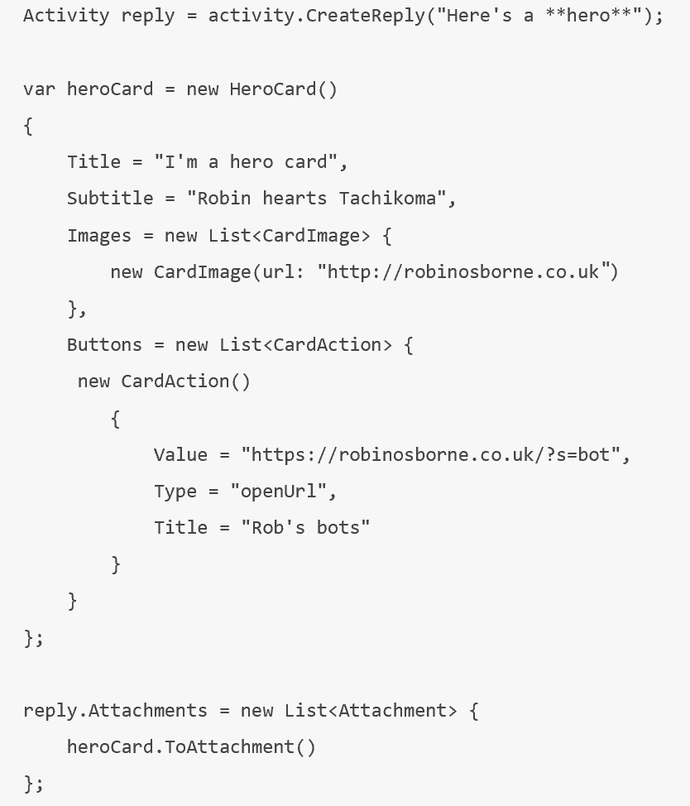
Creating Cards – Hero Card
The Hero card typically contains
a single large image, one or more
buttons, and text.

Slide 67
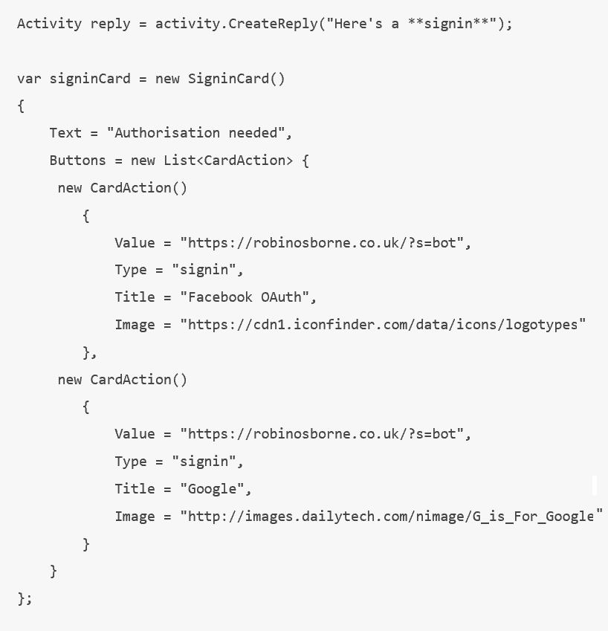
Creating Cards – Sign In Card
When the card action is set to the type of
“signin”, it can initiate an oauth flow; the
user can be made to leave the conversation
to authenticate with a third party system.

Slide 68
Intercept Messages
The middleware functionality in the Bot Builder SDK enables your bot to intercept all messages that are exchanged between user and bot
For message(s) that are intercepted,
save the message to a data store
write to a conversation log
inspect the message in some way and take whatever action your code specifies

Slide 69
Proactive Messages
Typically, each message that a bot sends to the user directly relates to the user's prior input
In some cases, a bot may need to send the user a message that is not directly related to the current topic of conversation. These types of messages are called proactive messages

Slide 70
Proactive Messages
Proactive messages can be useful in a variety of scenarios:
If a bot sets a timer or reminder, it will need to notify the user when the time arrives
If a bot receives a notification from an external system, it may need to communicate that information to the user immediately. For example, if the user wants the bot to monitor the price of a product, the bot will alert the user if it receives notification that the price of the product has dropped by 20%.

Slide 71
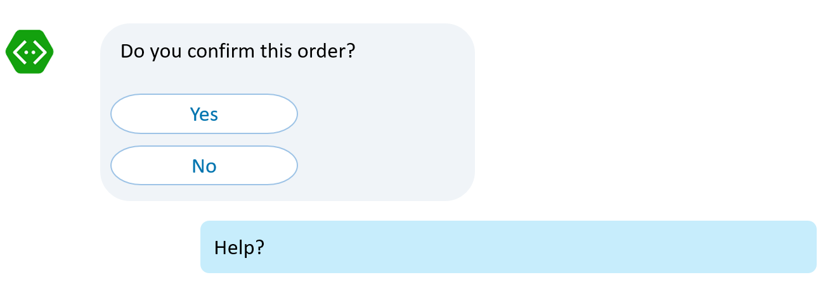
Global Message Handlers
Users commonly attempt to access certain functionality within a bot by using keywords like "help", "cancel", or "start over“
By implementing global message handlers, you can design your bot to gracefully handle such requests during different points of the conversation
The handlers will examine user input for the keywords that you specify, such as "help", "cancel", or "start over", and respond appropriately

Slide 72
Proactive Messages:
Types of Proactive Messages
Ad hoc proactive message
- The bot simply interjects the message into the conversation whenever it is triggered
- The bot will not attempt to change the conversation in any way
Dialog-based proactive message
- The bot must identify the context of the existing conversation before interrupting a conversation
- Decide how (or if) it will resume that conversation after the message interrupts

Slide 73
Connecting to Channels

Slide 74
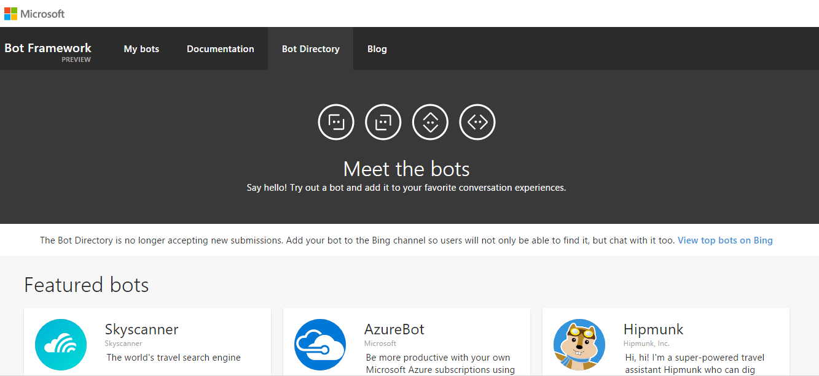
Making Your Bot Available
Bot Directory
Bing channel
Skype for Business
Channels have their own way of making bots available

Slide 75
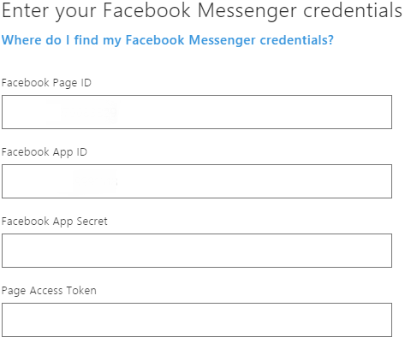
Third Party Channels
Example: Connect to Facebook Messenger
On the Bot Framework Portal, you will need Page ID, App ID, App Secret, and Page Access Token values obtained from Facebook Messenger
After the bot is finished, Facebook has its own review process for apps that are published to Messenger.
The bot will be tested to ensure it is compliant with Facebook's Platform Policies

Slide 76
Connect to Channels (Facebook)
Page ID
The bot is accessed through a Facebook Page
Create a new Facebook Page or go to an existing Page
Obtain the Page ID from Facebook Page's About page

Slide 77
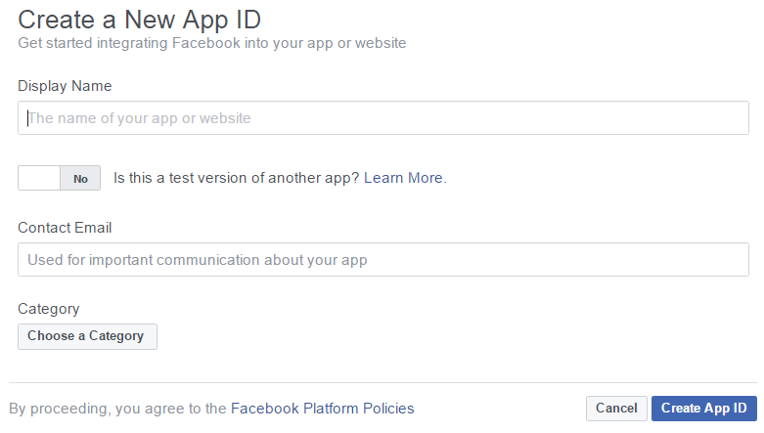
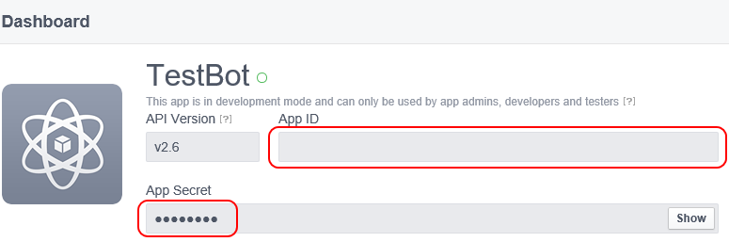
Connect to Channels (Facebook)
Facebook app
Create a new Facebook App on the Page and generate an App ID and App Secret for it
Obtain the App ID and the App Secret

Slide 78
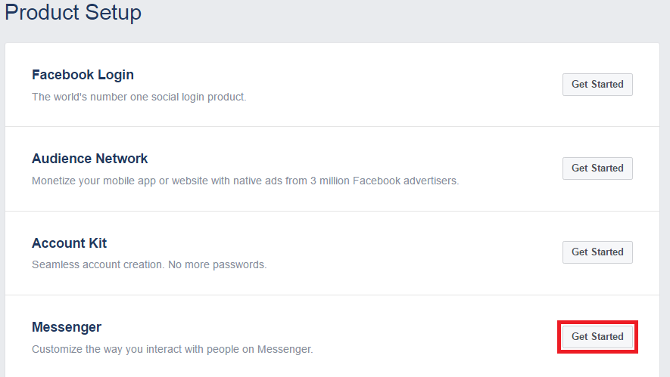
Connect to Channels (Facebook)
Enable messenger
Enable Facebook Messenger in the new Facebook App

Slide 79
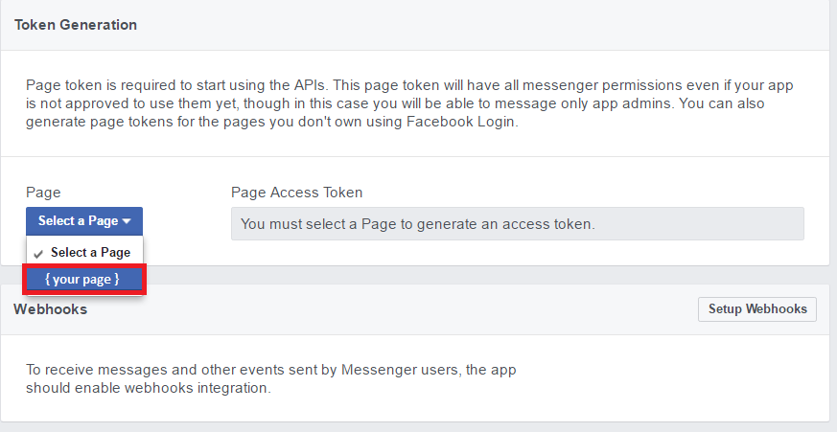
Connect to Channels (Facebook)
Generate a Page Access Token
In the Token Generation panel of the Messenger section, select the target Page. A Page Access Token will be generated.
Obtain the Page Access Token

Slide 80
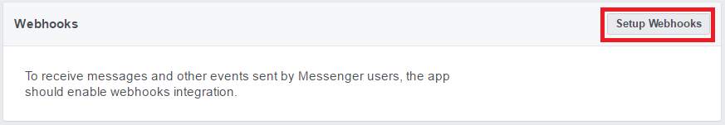
Connect to Channels (Facebook)
Enable webhooks
Click Set up Webhooks to forward messaging events from Facebook Messenger to the bot

Slide 81
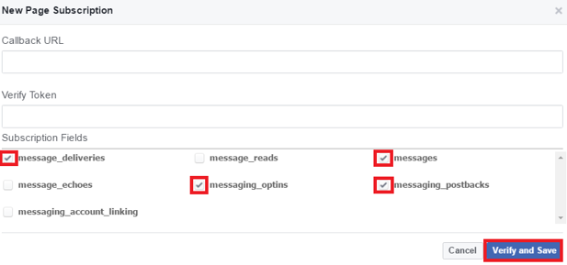
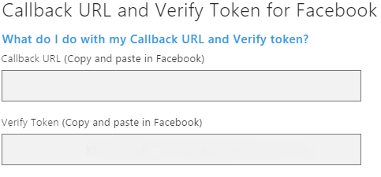
Connect to Channels (Facebook)
Provide webhook callback URL and verify token
In the Bot Framework Portal, open the bot, click the Channels tab, and then click Facebook Messenger.
Copy the Callback URL and Verify Token values from the portal
In Facebook Messenger, paste the Callback URL and Verify Token values
Under Subscription Fields, select message_deliveries, messages, messaging_options, and messaging_postbacks

Slide 82
LAB: BotsRichUILab

